Slide 1
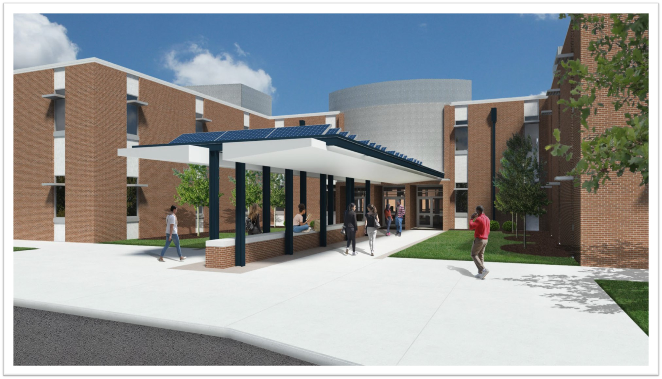
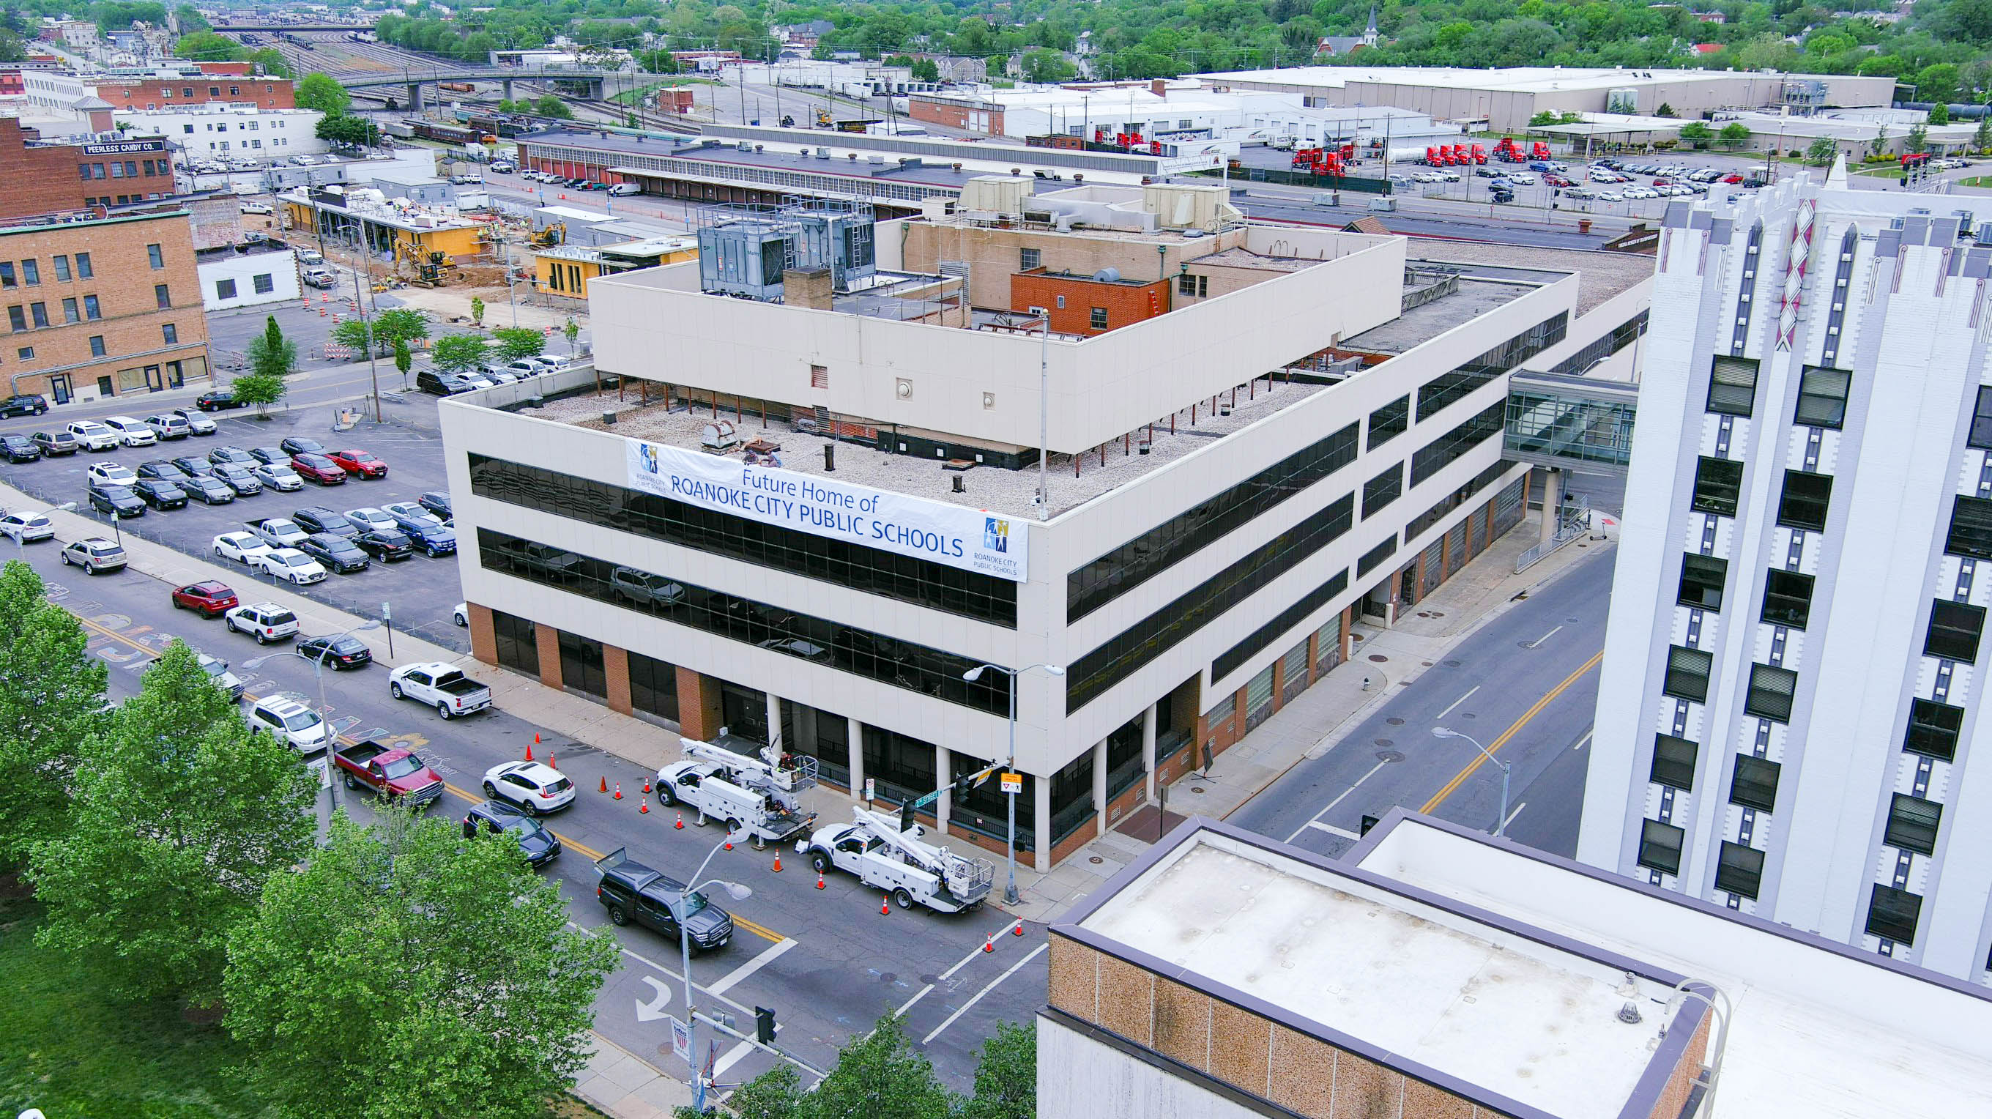
Building Name Nominations
Learn more about nominations that have been submitted to Roanoke City Public Schools’ Naming Committee. These names are being considered for the Administration Building on Campbell Avenue and/or the new Roanoke Technical Education Center adjacent to William Fleming High School.

Slide 2
For Consideration Solely for the Administration Building on Campbell

Slide 3
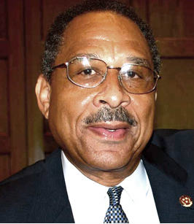
Dr. E. Wayne Harris (b. 1945)
Dr. Harris grew up in Salem and worked in Fairfax County Public Schools for 25 years before moving to Roanoke.
He was appointed as Superintendent in 1993, and was the first African American Superintendent of RCPS
Under his tenure, the percentage of students reading on grade level increased from 48 to 76 percent; the test score achievement gap narrowed between white and black students; and the dropout rate halved
  At the time, Roanoke was also one of only eight school systems in the U.S. to offer the International Baccalaureate program in all grade levels
  More Roanoke students than ever before took Advanced Placement and dual enrollment courses
“The academic improvements are indicators that Harris — with the commitment of principals and teachers — has introduced innovations that have made a strong mark on public education in Roanoke.”
– The Roanoke Times Editorial Board, 2004
Dr. Wayne Harris is a longtime educator who was Superintendent of RCPS from 1993 until his retirement in 2004.

Slide 4
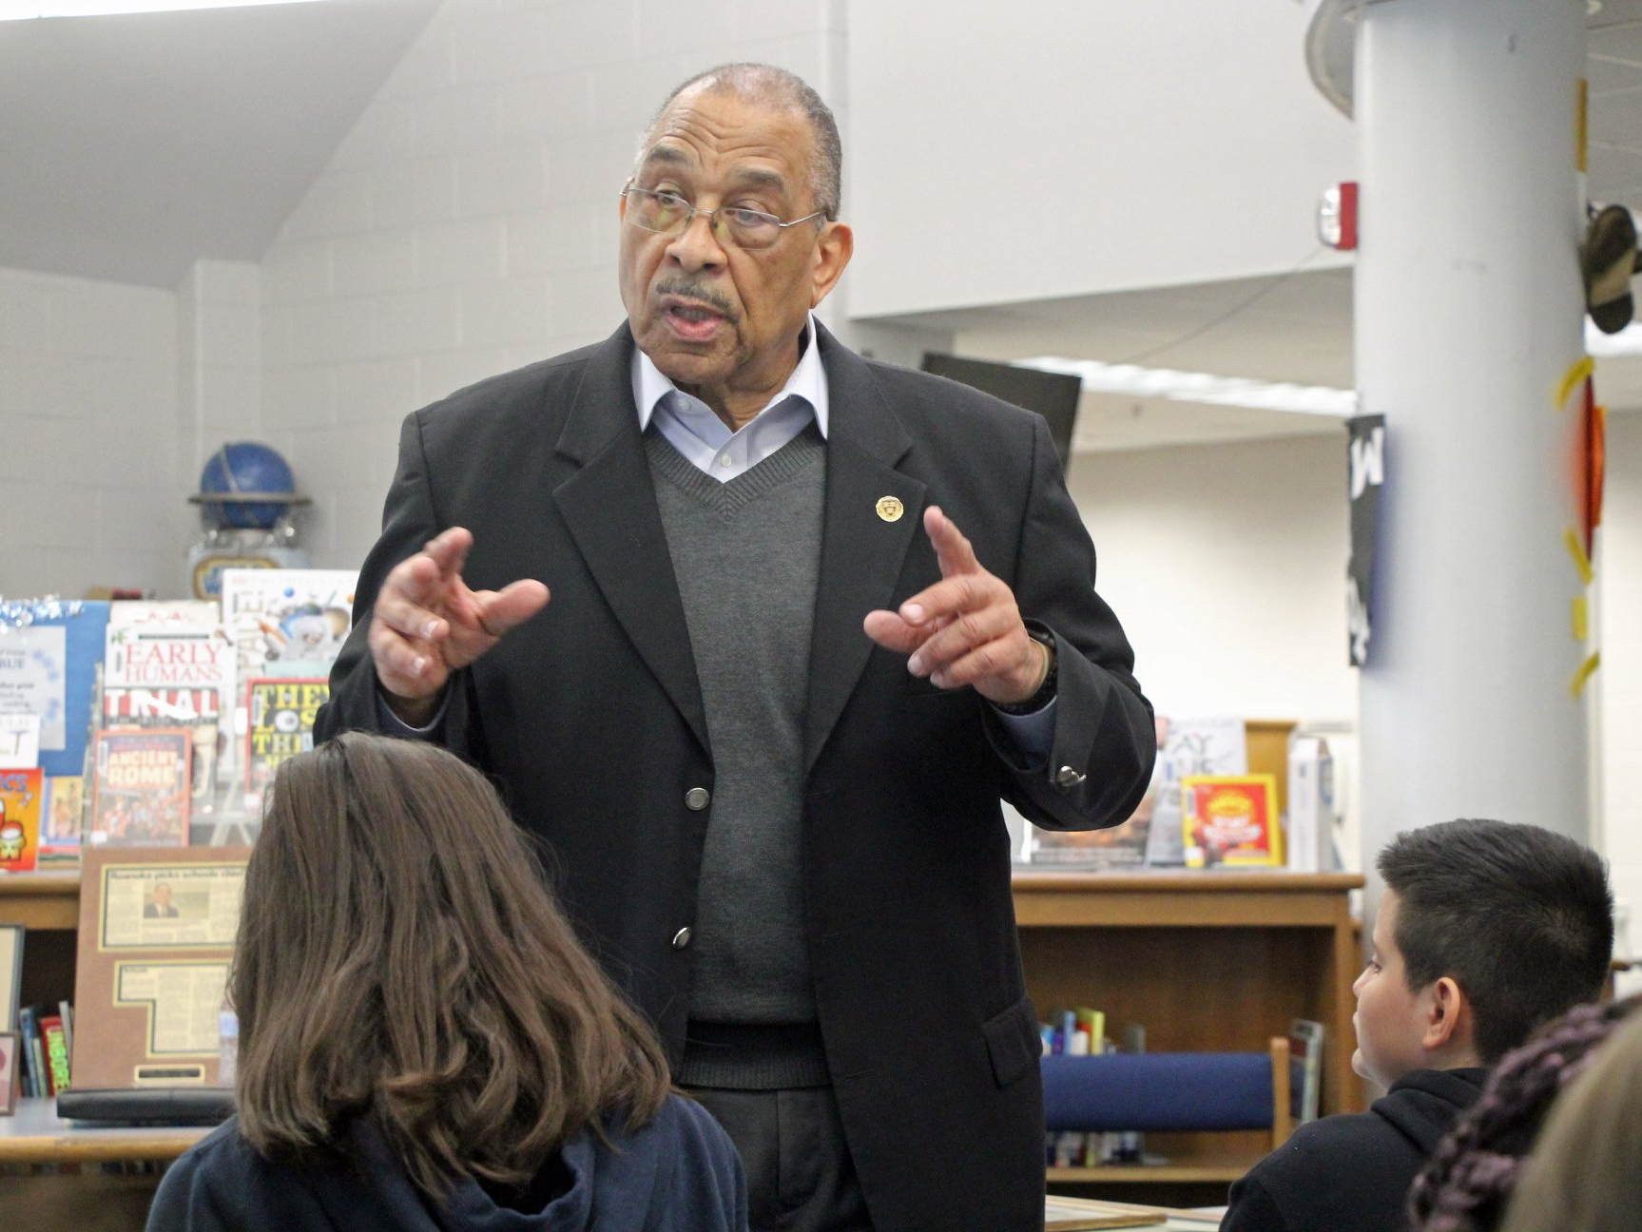
Dr. E. Wayne Harris (b. 1945)
Dr. Harris also initiated the regional “Partners for SUCCESS Program,” which provided 65 rising eighth grade students the opportunity to quality for a tuition-free college education.
Following his retirement, Dr. Harris designed and implemented the Schools Leaders Institute. He is also an Executive Coach for the Virginia Association of School Superintendents and is an Associate with Cambridge Strategic Services.
Dr. Harris was awarded the NAACP’s Lifetime Achievement Award in 2004 in honor of his life’s work and a Leadership in Arts Instruction Award in 2003 from the Virginia Board of Education and Virginia Commission of the Arts, among other recognitions

Slide 5
For Consideration Solely for the new Roanoke Technical Education Center Adjacent to William Fleming High School

Slide 6
Roanoke Center for Advancement in Technical Education
(RCATE)

Slide 7
For Consideration for Either Building

Slide 8
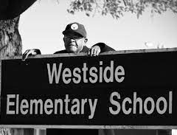
Wendell Ball (1942-2019)
Taught in RCPS for 44 years
Hired in 1968 to teach at Westside. While at Westside, Mr. Ball also worked summer school sessions and served as the school’s Safety Patrol sponsor
In 1989, Mr. Ball moved to William Ruffner Middle School, where he taught until he retired in 1998.
“He puts the needs and wants of others before his own nine times out of 10 with no complaints.”
– Jamyra Ball
Mr. Wendell Ball taught in RCPS for 44 years
and made a lasting impact on his students.

Slide 9
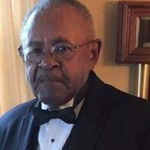
Wendell Ball (1942-2019)
Following retirement, he continued to work with the school system as a substitute teacher, during summer school, and in adult education
Well-loved by his students, Mr. Ball taught multiple generations and made a lasting impact on them.

Slide 10
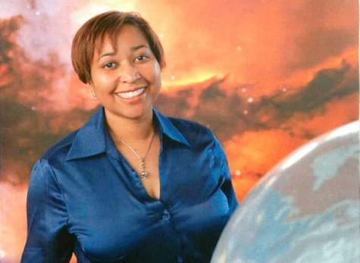
Dr. Beth Brown (1969-2008)
Dr. Brown attributed her defining interest in astronomy to a class field trip in high school, where she observed the Ring Nebula. She went on to graduate from William Fleming High School in 1987 as valedictorian.
She was the first African American woman to obtain a doctorate from the University of Michigan’s Department of Astronomy
Dr. Brown began working for NASA in 1998. During her career, she focused her research on x-ray observations of elliptical galaxies and black holes.
She was known for her public outreach to make astronomy more accessible, which included teaching classes at the University of Michigan and her undergraduate alma mater, Howard University. She also mentored and supported women and minorities who entered the field.
“Although her time working in the professional astronomical community was short, she had a significant impact on our discipline; not least by serving as a role model for many students from underrepresented groups.”
– American Astronomical Association
Dr. Beth Brown graduated from William Fleming High School and
went on to become a NASA astrophysicist.

Slide 11
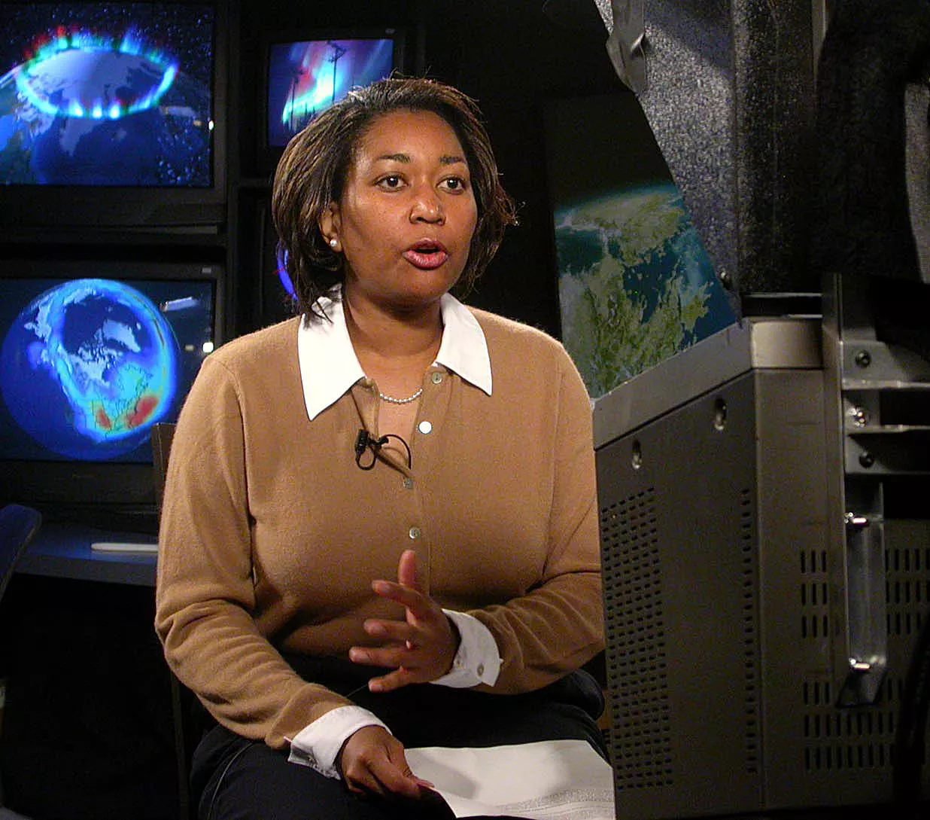
Dr. Beth Brown (1969-2008)
Dr. Brown died unexpectedly in 2008 from a pulmonary embolism.
Posthumously, she has been honored at the local, state, and national level:
  Her parents began the Dr. Beth A. Brown Science Foundation, which provides scholarships to local graduating high school seniors who major in astronomy or physics.
  The American Astronomical Association supports an award program in memory of Dr. Brown connected with the National Society of Black Physicists’ annual meeting.
  In 2015, Dr. Brown was one of eight honorees at Dominion Energy and The Library of Virginia’s annual Strong Men and Women in Virginia History Awards.

Slide 12
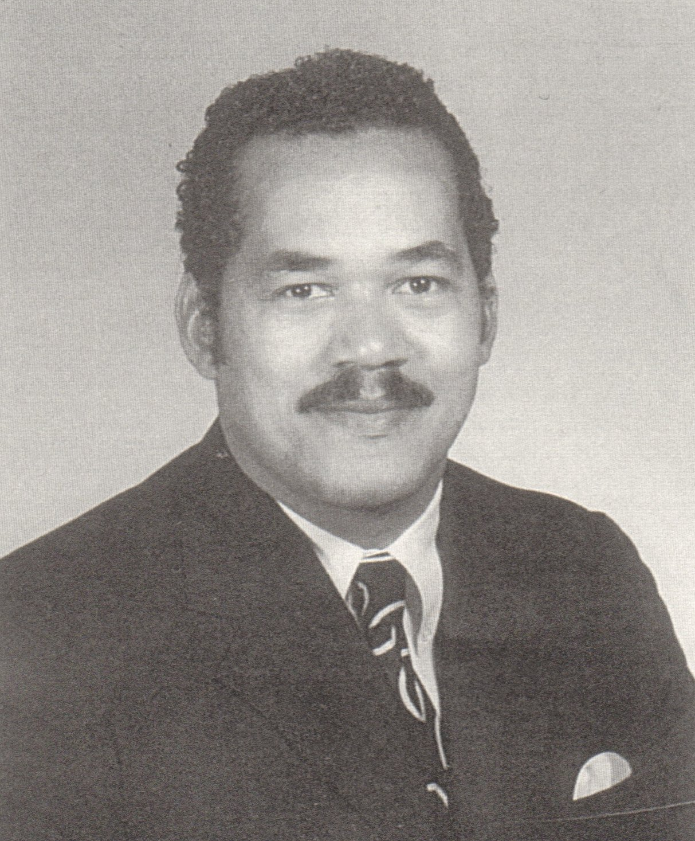
Charles Day (1934-2015)
Mr. Day worked in education for 30 years after serving in the U.S. Army
At the beginning of his career, he was a Teacher/Coach at Central High School in Amherst and Principal at Friends Elementary in Christiansburg.
He moved to Roanoke in 1966, where he remained for the rest of his career. He served in the following roles within RCPS:
  Counselor/Coach at Lucy Addison High School
  Principal at Loudon Elementary School
  Principal at Lucy Addison High School
  Principal at William Ruffner Middle School
  Associate Principal at Patrick Henry High School
  and Principal at Westside Elementary School.
“His calm demeanor and comfortable approach was greatly appreciated by many people as he worked diligently to ensure that all members of the community felt welcome.”
– House of Delegates Joint Resolution
Mr. Charles Day was a longtime RCPS educator and School Board member who supported students during integration and made all students feel included.

Slide 13
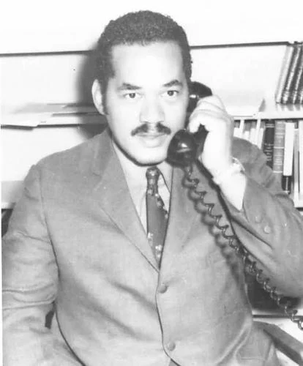
Charles Day (1934-2015)
While Principal at Lucy Addison, Mr. Day presided over the school’s integration and was one of the few African American Principals in Virginia at the time
Later, Mr. Day served on the Roanoke City School Board for 12 years, including one year as Chairman.
Following retirement, Mr. Day was also a counselor at Virginia Western Community College and served as an administrative law test administrator
Former students recall that Mr. Day never forgot their names, and that he had a way of making all students feel included and appreciated.

Slide 14
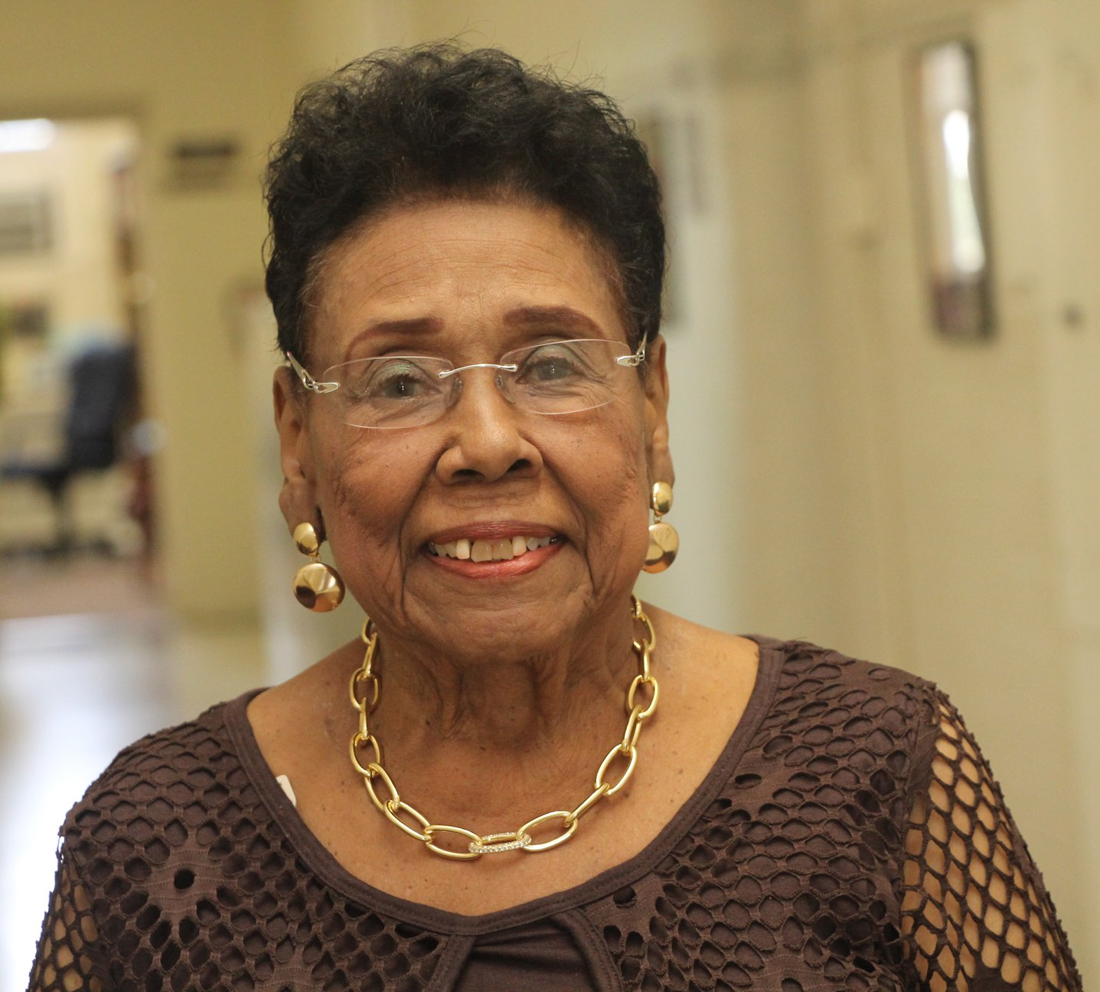
Doris Ennis (b. 1938)
Mrs. Ennis was hired by RCPS in 1962 and began her career as an English teacher at Booker T. Washington Junior High School.
She moved to Patrick Henry High School in 1969 as one of the first two African American educators at Patrick Henry, the last Roanoke school to desegregate
  A year later, African American students enrolled at Patrick Henry, and Mrs. Ennis played a key role in supporting students and creating a dialogue of understanding
“Doris has no personal agenda. I have never seen her be unprofessional for a single second. It’s all for the kids.”
– Former Superintendent Dr. Rita Bishop
Mrs. Doris Ennis is a longtime educator whose
career has spanned more than 50 years in many roles, from Teacher to Acting Superintendent, and who is a pillar in the Roanoke community.

Slide 15
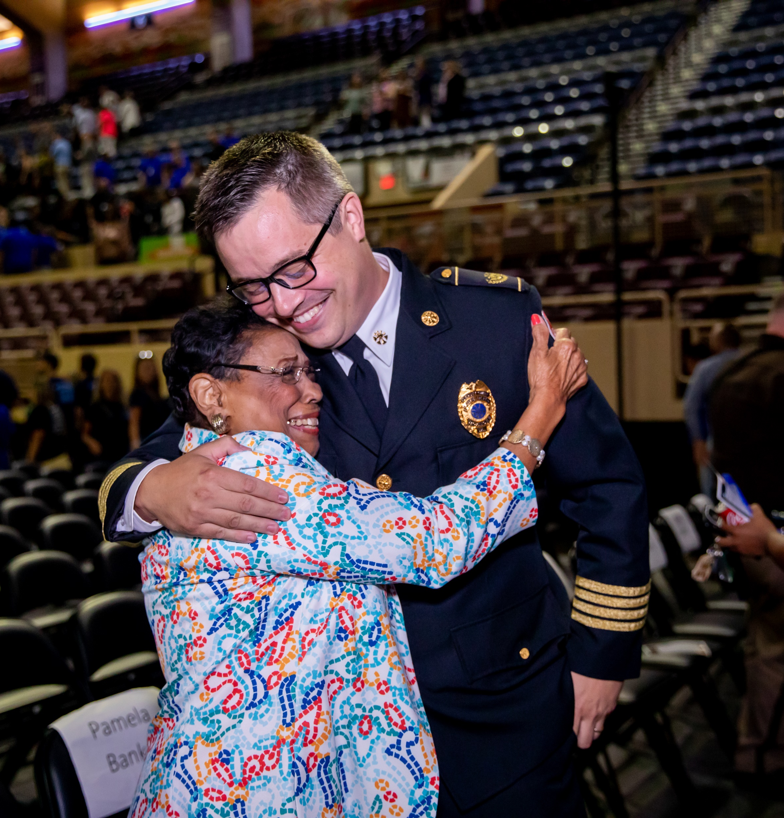
Doris Ennis (b. 1938)
Mrs. Ennis has retired on five different occasions but returned on special assignments in times of need, including as:
  Acting Superintendent
  Administrator on Special Assignment
  Community Liaison/Cultural Coach
Even after retiring in 2020, Mrs. Ennis continues to act as an educator emerita, attending RCPS events and providing guidance and support
Mrs. Ennis was awarded the NAACP’s Lifetime Achievement Award in 2013. Also in 2013, she received Roanoke College’s Margaret Sue Copenhaver Contribution to Education Award. She received a Key to the City and an NAACP Citizen of the Year Award in 2005.

Slide 16
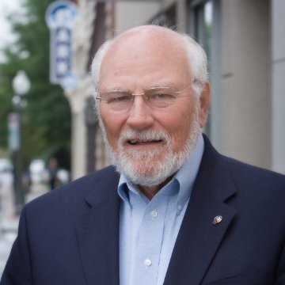
Lloyd Enoch (b. 1935)
Mr. Enoch was originally hired as Supervisor of Distributive Education, and for more than 30 years led the vocational (later called Career & Technical Education) and continuing/adult education programs
Under Mr. Enoch’s leadership, RCPS revitalized its CTE program to be unified and forward-thinking, which included the creation of the Roanoke Technical Education Center in 2006.
The creation of ROTEC led to an expansion of the CTE program, which has become extremely popular and has benefitted students and regional businesses
“He really took ROTEC to the next level. He built the foundation for what ROTEC is today.”
— Career & Technical Education Director Kathy Duncan
Mr. Lloyd Enoch is a longtime director of RCPS’
Career & Technical Education (CTE) and was
instrumental in the creation of the modern-day
Roanoke Technical Education Center.

Slide 17
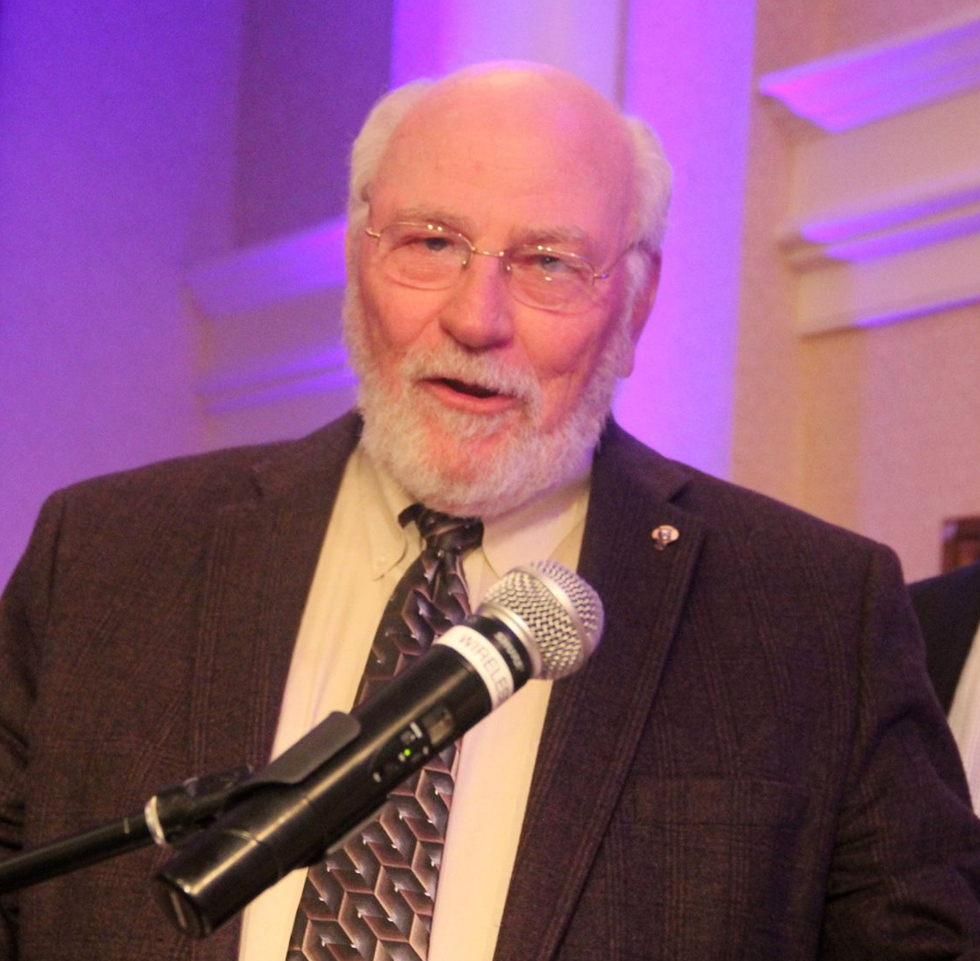
Lloyd Enoch (b. 1935)
After his retirement in 2002, Mr. Enoch continued to work part-time with RCPS until 2008. He led Blue Ridge Technical Academy, a short-lived regional charter school for CTE, and continued to lead CTE programs within RCPS
The Roanoke Technical Education Center now has a scholarship for achieving seniors named in his honor

Slide 18
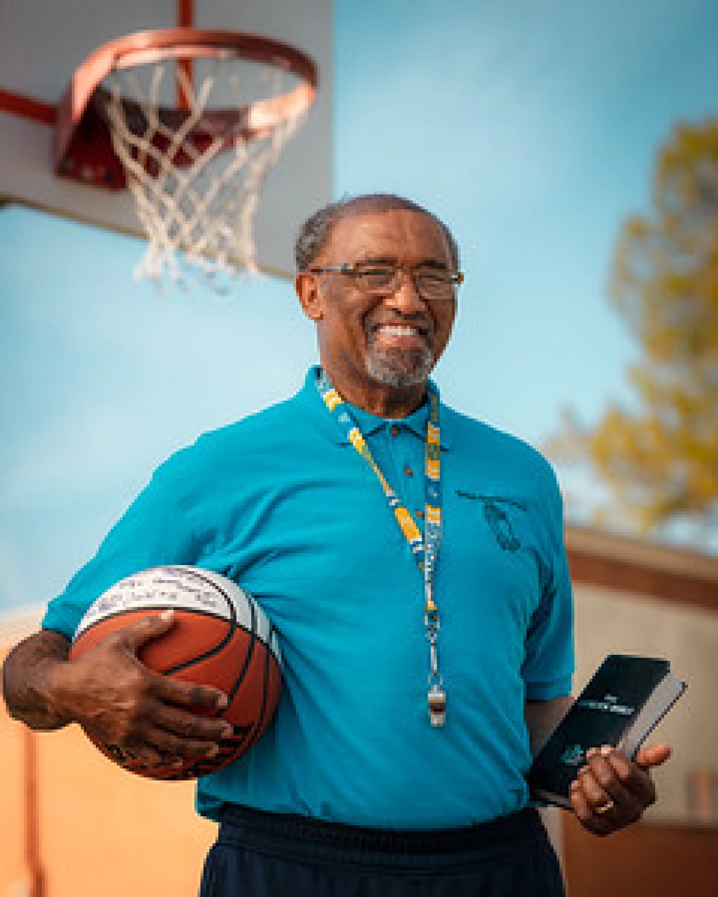
Joe Gaither (b. 1949)
Youth basketball coach of 40+ years who has mentored thousands of young people and led teams to regional and national championships
Mr. Gaither grew up in Salem and attended the segregated G.W. Carver High School and later Andrew Lewis High School, where he was a standout basketball player
Following graduation, Mr. Gaither served in the U.S. Army during the Vietnam War
Mr. Joe Gaither is a longtime youth basketball coach who has mentored thousands of young people.
“Coach Gaither has always been about helping young people; making them strive to the best of their ability.”
– Gary Bannister

Slide 19
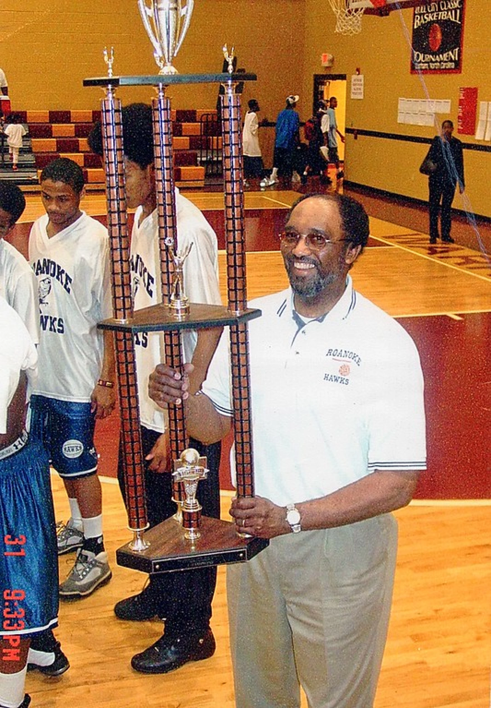
Joe Gaither (b. 1949)
In the 1970s, Mr. Gaither began coaching basketball and volunteered with Roanoke’s Inner City Athletic Association and Amateur Athletics Association.
  He also coached at William Fleming High School, Roanoke Catholic School, and Virginia Episcopal School in Lynchburg.
Mr. Gaither has provided opportunities to many young people who wouldn’t have otherwise been able to afford playing sports, and a network of volunteers and community partners have provided lifelong mentorship off the court.

Slide 20
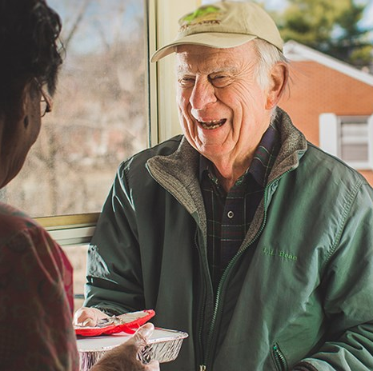
George Andrew Kegley (1928-2022)
  Mr. Kegley graduated from Roanoke College and spent his entire career at The Roanoke Times, where he was a reporter and later the paper’s business editor
    He also served in the U.S. Army for two years
  Active in volunteering throughout his career, after retiring in 1993, Mr. Kegley became a “full-time” volunteer (Involvement detailed on next slide)
  Mr. Kegley was awarded the Roanoke College Medal in 1985 and Total Action for Progress’ inaugural Legacy Award in 2019, among other awards
  The Roanoke Valley Preservation Foundation presents an annual award in his name
“George was sort of this walking encyclopedia of everything that was going on in Roanoke. He was just a great resource for the newsroom to have.”
– Rich Martin, former Roanoke Times
Managing Editor
Mr. George Kegley was a Reporter and Business Editor for 44 years at The Roanoke Times and a dedicated volunteer for many civic and charitable causes.

Slide 21
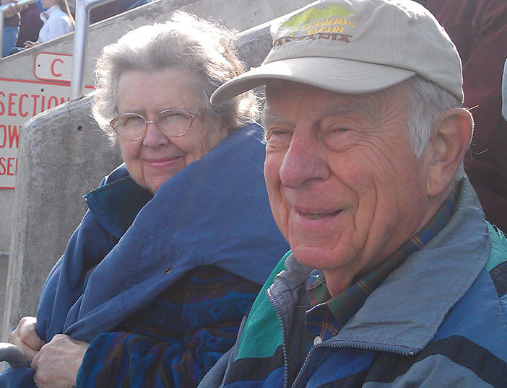
George Andrew Kegley (1928-2022)
  Mr. Kegley helped to establish the Roanoke Valley Preservation Foundation, and he and his wife donated a large easement on their 116-acre farm to the Virginia Outdoors Foundation & Department of Historic Resources, the first conservation easement within Roanoke City limits.
  He was involved with the Historical Society of Western Virginia since it was founded in 1957, including as president and board member.
  He was also a long-time volunteer with Meals on Wheels, spent more than 18 years volunteering at the RAM House, and worked to improve the lives of refugees in the Roanoke Valley for more than 40 years
  Mr. Kegley became a blood donor after writing about the American Red Cross as a reporter and donated 60 gallons over the course of his lifetime

Slide 22
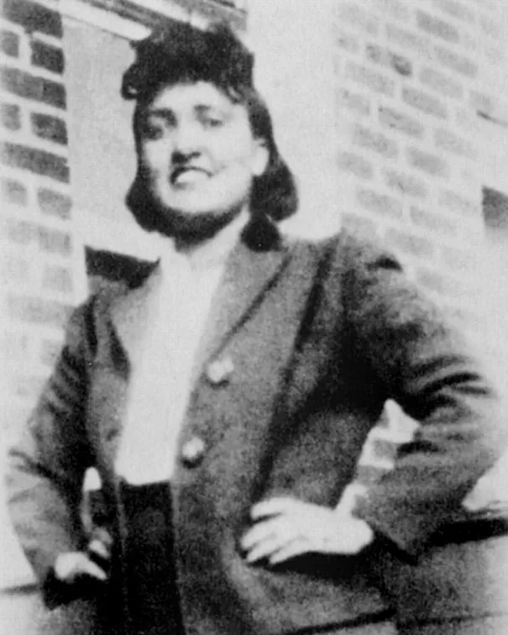
Henrietta Lacks (1920-1951)
  Mrs. Lacks was born Loretta Pleasant in Roanoke. She moved to Clover, Virginia in 1924, where she grew up. She later lived in Baltimore, where she died in 1951 from cervical cancer.
  While being treated at Johns Hopkins Hospital, a surgeon obtained two tissue samples from her without her knowledge or consent.
  Doctors discovered the tumor cells, known as “HeLa cells,” began to grow continuously at an unprecedented rate. This immortal cell line has been used in medical research around the world, multiplied billions of times.
“Because of their unique ability to reproduce indefinitely, HeLa cells have been instrumental in the development of the polio vaccine, cancer treatment protocols, AIDS research, and much more, and they continue to play an important role … worldwide.”
– Johns Hopkins University
Mrs. Henrietta Lacks was a Roanoke native who is infamous for her “immortal cells” that have benefitted medical research around the world.

Slide 23
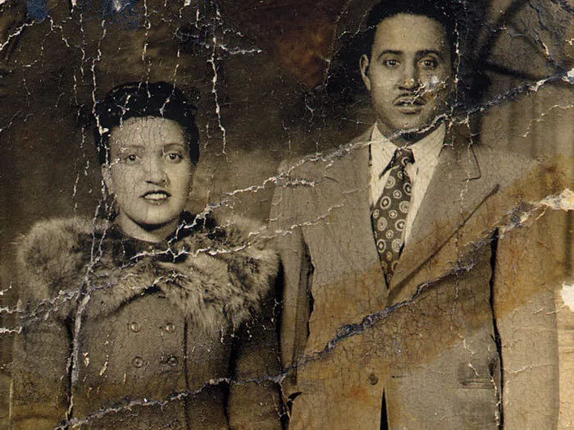
Henrietta Lacks (1920-1951)
  Mrs. Lacks’ cells have contributed to nearly 75,000 studies, including:
    Groundwork for development of the Polio Vaccine
    Used to determine how radiation can damage cells
    Development of cancer research methods
    An outer space visit to show how radiation affects cells
    and how space travel affects astronauts
    Development of the HPV vaccine against cervical cancer
    Other research and development of treatments for diseases including HIV, tuberculosis, and more.
  Neither Mrs. Lacks or her family knew about the samples at the time they were taken, and her family did not find out until the 1970s. This has led to national conversations about whether the samples should have been taken in the first place, what compensation the family is entitled to, and other ethical questions.

Slide 24
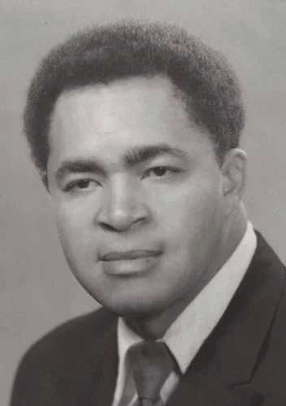
William “Bill” Robertson (1933-2021)
  A native of Roanoke, Mr. Robertson graduated from Lucy Addison High School. He returned following college to teach at Lucy Addison, Gilmer Elementary School, and Lee Junior High before becoming principal of Hurt Park Elementary School.
    Mr. Robertson helped to integrate the faculty of Lee Junior High in 1965
  He took a leave of absence from 1970 to 1973 to serve as an adviser to Gov. Linwood Holton, who ended Massive Resistance, the state’s anti-desegregation policy.
    Before being appointed, Mr. Robertson became the first African American person in Virginia to run for the General Assembly
Mr. Bill Robertson was an educator and trailblazing public servant who worked for RCPS before becoming the first African American adviser to a Virginia governor. He later worked under five presidential administrations.
“He has had a significant impact on the lives of others. His legacy of service and leadership … is indeed exemplary.”
– Robin Capehart, President of Bluefield State College

Slide 25
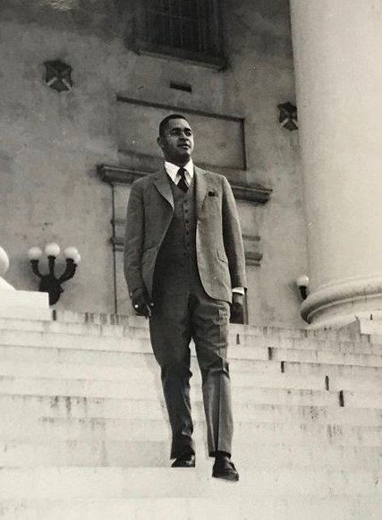
William “Bill” Robertson (1933-2021)
  Mr. Robertson was the first African American to serve as an executive-level aide to a Virginia governor, which made national news
    As an adviser, Mr. Robertson worked to integrate state agencies
  Mr. Robertson served in five presidential administrations in a variety of roles, including:
    In an executive capacity with the U.S. Department of State
    Director of the Peace Corps for Kenya and the Seychelles
    Deputy Assistant Secretary of State for African Affairs
    Serving on multiple federal committees and task forces
  Following his retirement, he returned to education and taught in Tampa, Florida
  Throughout his life, Mr. Robertson advocated for civil rights and disability rights. Mr. Robertson created Camp Virginia Jaycee, a retreat for children and adults with intellectual and developmental disabilities that operated from 1971 to 2017

Slide 26
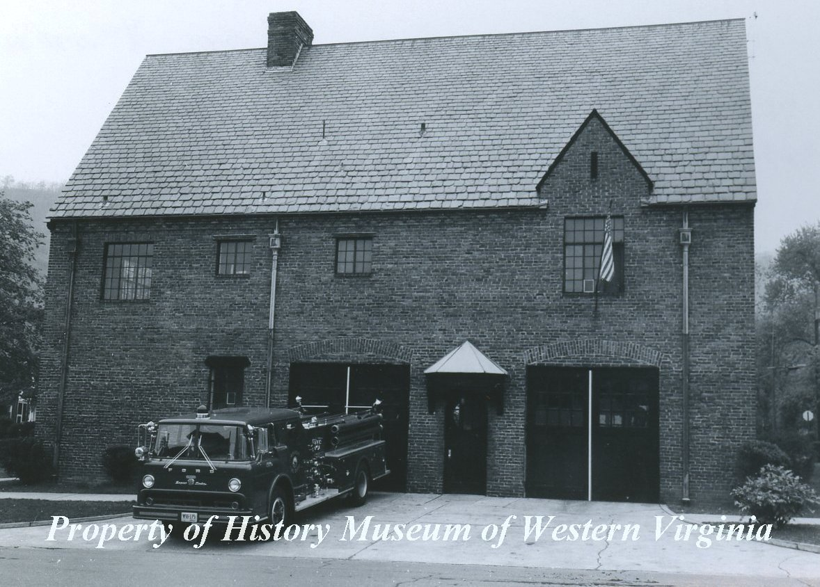
Louis Phillipe Smithey (1890-1966)
  Mr. Smithey worked as an engineer for Virginia Bridge and Iron Company before serving in the U.S. Army during WWI and WWII
  He and Henry Boynton co-founded Smithey & Boynton Architects and engineers in 1935
  The firm was best known for building public schools
    Mr. Smithey designed 150 schools in at least 19 counties and 10 cities in Virginia
    The firm served as consulting architects for RCPS
“As the firm of Smithey and Boynton, these two gentlemen would become arguably the most important architects of their era in Virginia west of Richmond and responsible for a great deal of the residential, commercial, sacred, and most of the institutional architecture of the region between 1935 and the 1960s.”
– Mike Walker, Reporter
  Mr. Louis Smithey was an architect whose firm was known throughout Southwest Virginia and West Virginia for designing public schools and other landmark buildings, including RCPS buildings.

Slide 27
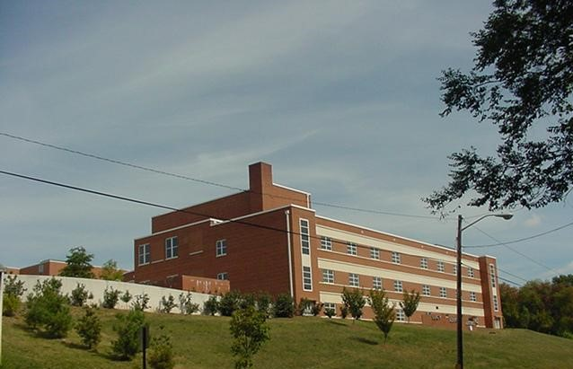
Louis Phillipe Smithey (1890-1966)
  It is unclear which schools he may have designed, but his architectural firm later designed the original Fallon Park Elementary School (1974), what is now known as the Roanoke Technical Education Center at Gibboney Hall (1976), and the current Lucy Addison Middle School (1992)
  Smithey & Boynton also designed Lane Stadium, several other Virginia Tech buildings, the Lyric Theatre in Blacksburg, buildings for Norfolk & Southern, the South Roanoke Fire Station, and other landmark buildings

Slide 28
Share Your Feedback Today!
We hope this presentation was helpful in learning more about the nominations! Please take a few moments to visit the link below and fill out a survey to provide your input on the naming nominations. Your input will be used by the Naming Committee to create a list of ranked recommendations for the School Board.
Please note: School Board policy FFA grants the School Board the final say on the naming of buildings, including whether a building is ultimately named. All living nominees have provided consent for their names to be considered, and a good-faith effort has been made to obtain consent from relatives of nominees who are deceased.
Click here to take the survey!

